Slide 1
Combined general Architecture
OBJECTIVE
To design a system architecture to deploy an ML model in production, we will focus on creating a scalable, maintainable, and efficient deployment pipeline. This architecture will leverage containerization, continuous integration/continuous deployment (CI/CD), and monitoring to ensure smooth and reliable operation.
-By Saurabha Wankhede

Slide 2
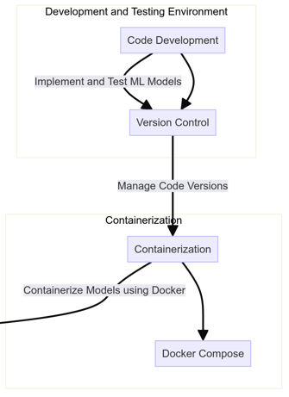
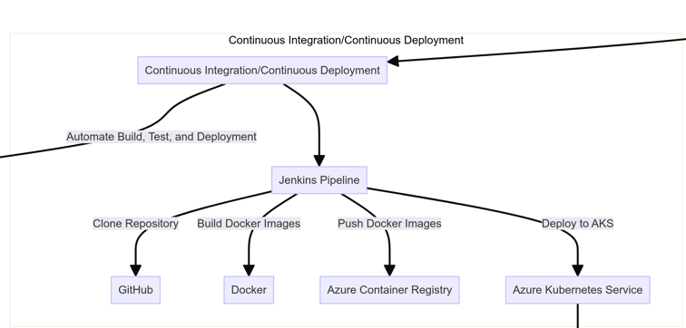
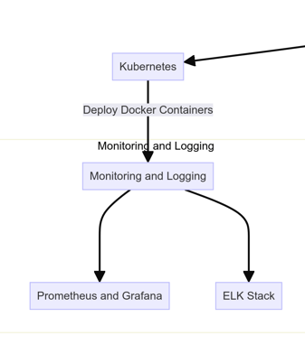
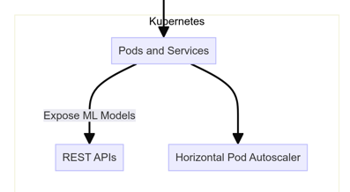
End to End Flow and Architecture

Slide 3
Overview
High-Level System Design
1. Development and Testing Environment
Code Development: Implementing and testing ML models using Jupyter notebooks or a local development environment.
Version Control: Using GitHub to manage code versions
2. Containerization
Docker: Containerize the ML models using Docker to ensure consistency across different environments. Create Dockerfiles for both spaCy and BERT models.
Docker Compose: Use Docker Compose for defining and running multi-container Docker applications.

Slide 4
Overview
3. Continuous Integration/Continuous Deployment (CI/CD)
Jenkins: Setting up a Jenkins pipeline for automating the build, test, and deployment processes.
Stage 1: Clone the repository from GitHub.
Stage 2: Build Docker images using the Dockerfiles.
Stage 3: Push the Docker images to Azure Container Registry (ACR).
Stage 4: Deploy the containers to Azure Kubernetes Service (AKS) using YAML files for defining Kubernetes resources.
4. Kubernetes
Azure Kubernetes Service (AKS): Deploy the Docker containers in a scalable and managed Kubernetes environment.
Pods and Services: Define Pods and Services using YAML files. The services will expose the ML models through REST APIs.
Horizontal Pod Autoscaler (HPA): Set up HPA to automatically scale the number of pods based on CPU/memory usage.
5. Monitoring and Logging
Prometheus and Grafana: Using Prometheus for monitoring and Grafana for visualization.
ELK Stack: Set up the ELK (Elasticsearch, Logstash, Kibana) stack for centralized logging and log analysis.

Slide 5
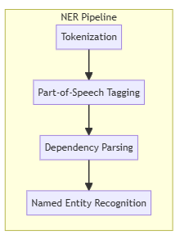
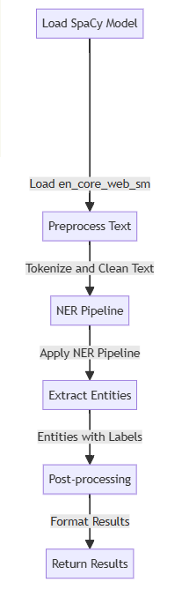
System Architecture for Deploying SpaCy Model
1. Data Preprocessing and Annotation:
- Load and preprocess data.
- Annotate data using SpaCy.
2. Model Training:
- Train the NER model with SpaCy.
- Save the trained model and DocBin
objects for train, validation,
and test sets.
3. Containerization with Docker:
- Create a Dockerfile to containerize the SpaCy model and dependencies.
- Build the Docker image and push it to a container registry.

Slide 6
4. Continuous Integration/Continuous Deployment (CI/CD):
- Set up a CI/CD pipeline using Jenkins.
- Integrate the pipeline with GitHub for automatic deployments.
- Use YAML files for Kubernetes deployments
5. Model Deployment:
- Deploy the model using Kubernetes.
- Expose the model via an API endpoint using Flask or FastAPI.
- Enable load balancing and auto-scaling.
6. Inference:
- Handle incoming requests for NER predictions.
- Process and return NER predictions via the API.
7. Monitoring and Maintenance:
- Monitor the model’s performance and track metrics.
- Implement logging and error handling.
- Handle data drift and model drift through periodic retraining and updates.

Slide 7
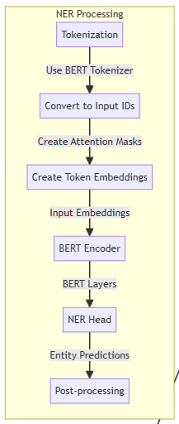
System Architecture for Deploying BERT Model
1. Data Preprocessing:
- Load and preprocess data.
- Tokenize and align labels using the BERT tokenizer.
2. Model Fine-Tuning:
- Load a pre-trained BERT model and fine-tune it for NER.
- Save the fine-tuned model.
3. Containerization with Docker:
- Create a Dockerfile to containerize the BERT model and dependencies.
- Build the Docker image and push it to a container registry.

Slide 8

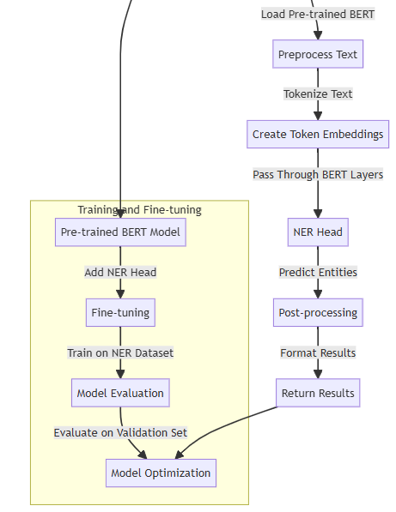
4. Continuous Integration/Continuous Deployment (CI/CD):
- Set up a CI/CD pipeline using Jenkins.
- Integrate the pipeline with GitHub for automatic deployments.
- Use YAML files for Kubernetes deployments.
5. Model Deployment:
- Deploy the model using Kubernetes.
- Expose the model via an API endpoint using Flask or FastAPI.
- Enable load balancing and auto-scaling.
6. Inference:
- Handle incoming requests for NER predictions.
- Process and return NER predictions via the API.
7. Monitoring and Maintenance:
- Monitor the model’s performance and track metrics.
- Implement logging and error handling.
- Handle data drift and model drift through periodic retraining and updates.

